Slide 1
CBS as Evolution Science:
Why it Matters to the Long Term
Global Impact of our Work
Steven C. Hayes
University of Nevada

Slide 2
My Argument
The reunification of contextual behavioral science and evolution science is necessary to the fulfillment of our purpose and our goal
CBS is progressing because of that reunification but historically some of our ideas have been excluded from the cultural conversation because evolution was mishandled in the last century
The global impact of CBS will be fostered by redirecting evolution science itself
Notes:
There was no “black box” and no “tabula rasa”
The analysis of biological systems based on variation and selective retention.
My biases are more (b)VSR than BVSR (and the symbolic stream is a good reason why).

Slide 3
Our Overall Purpose in CBS
Creating a behavioral science more worthy of the challenge of the human condition
Notes:
There was no “black box” and no “tabula rasa”
The analysis of biological systems based on variation and selective retention.
My biases are more (b)VSR than BVSR (and the symbolic stream is a good reason why).

Slide 4
Our Proximal Goal
Predicting and influencing – with precision, scope, and depth – whole organisms interacting in and with a context considered historically and situationally.
Notes:
There was no “black box” and no “tabula rasa”
The analysis of biological systems based on variation and selective retention.
My biases are more (b)VSR than BVSR (and the symbolic stream is a good reason why).

Slide 5
Depth Means
No gaps in the fabric of science
As a monistic field we view behavioral science as part of the life sciences and biology
BUT our core units include context considered historically and situationally
So how is contextual behavioral science going to deal with biology and neuroscience?
Notes:
There was no “black box” and no “tabula rasa”
The analysis of biological systems based on variation and selective retention.
My biases are more (b)VSR than BVSR (and the symbolic stream is a good reason why).

Slide 6
While not Rejecting it, CBS is Cautious About Biological Causality
“Cause” is a functional term and thus causes need to be manipulable
It often seems to diminish a focus on history and situation – on context
And the brain and body are dependent variables, not just independent variables
But there is another way forward
Notes:
There was no “black box” and no “tabula rasa”
The analysis of biological systems based on variation and selective retention.
My biases are more (b)VSR than BVSR (and the symbolic stream is a good reason why).

Slide 7
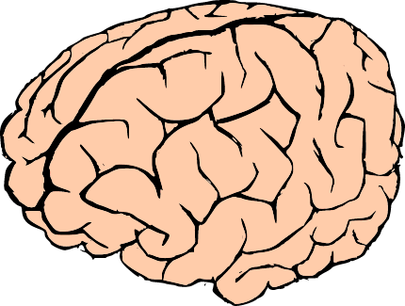
Ask Any Biologist: Why does This Exist and Why Does it Have the Function it Has?
Because it
evolved
that way
Notes:
There was no “black box” and no “tabula rasa”
The analysis of biological systems based on variation and selective retention.
My biases are more (b)VSR than BVSR (and the symbolic stream is a good reason why).

Slide 8
True of Any Biological Feature
“nothing in biology makes sense except in the light of evolution” (Dobzhansky, 1973)
But evolution is all about context; it is all about history and situation
Biology based on evolution fits easily with a functional contextual perspective
Notes:
There was no “black box” and no “tabula rasa”
The analysis of biological systems based on variation and selective retention.
My biases are more (b)VSR than BVSR (and the symbolic stream is a good reason why).

Slide 9
Behavioral Psychology is a Kind of Evolutionary Psychology
“human behavior is the joint product of (i) the contingencies of survival responsible for the natural selection of the species and (ii) the contingencies of reinforcement responsible for the repertoires acquired by its members, including (iii) the special contingencies maintained by an evolved social environment. Ultimately, of course, it is all a matter of natural selection, since operant conditioning is an evolved process, of which cultural practices are special applications.” (Skinner, 1981, p. 502).
Notes:
There was no “black box” and no “tabula rasa”
The analysis of biological systems based on variation and selective retention.
My biases are more (b)VSR than BVSR (and the symbolic stream is a good reason why).

Slide 10
This Was Rejected by
Most Evolutionists
1. Genes and memes are life and death; operants are not;
2. Gene centrism
Still today it is a problem: here is Bridgeman’s (2003) definition of evolution from Psychology and evolution: The origins of mind: “A change in gene frequencies in a species due to selective survival” (p. 325).
Notes:
There was no “black box” and no “tabula rasa”
The analysis of biological systems based on variation and selective retention.
My biases are more (b)VSR than BVSR (and the symbolic stream is a good reason why).

Slide 11
It is Time to Bury Gene Centrism
It is factually false
It has prevented the proper alliance of the biological and behavioral sciences
It has made evolving on purpose one of the most dangerous ideas of the last century, hindering the use of functional contextual thinking more generally as part of the global response to human challenges
Notes:
There was no “black box” and no “tabula rasa”
The analysis of biological systems based on variation and selective retention.
My biases are more (b)VSR than BVSR (and the symbolic stream is a good reason why).

Slide 12


Slide 13
Gene Centrism
Has linked evolution on purpose to the death of millions
The Second World War is the cultural context in which behavior modification = “Clockwork Orange” or psychosurgery
I personally feel a special obligation to help put this right; this issue is linked in sad ways to why ACT exists
We as a community can and should help
Notes:
There was no “black box” and no “tabula rasa”
The analysis of biological systems based on variation and selective retention.
My biases are more (b)VSR than BVSR (and the symbolic stream is a good reason why).

Slide 14
The Failure of Simple
Genetic Causality
Enormous progress with the human genome shows that the idea that genes code for phenotypic traits is generally false
Notes:
There was no “black box” and no “tabula rasa”
The analysis of biological systems based on variation and selective retention.
My biases are more (b)VSR than BVSR (and the symbolic stream is a good reason why).

Slide 15
Recent Example (October 2014)
Genetic Investigation of Anthropometric Traits (GIANT) Consortium
250,000 subjects, full genomic mapping
Height is sensitive to 424 gene regions
Can still only account for 20% of the variance in height
Notes:
There was no “black box” and no “tabula rasa”
The analysis of biological systems based on variation and selective retention.
My biases are more (b)VSR than BVSR (and the symbolic stream is a good reason why).

Slide 16
In Psychopathology
Psychiatric Genomic Consortium in 2013 reported on a study with 60,000 people; full genomic mapping
They found a handful of single nucleotide polymorphisms that predicted 1-2% of psychopathology but it was not diagnosis specific
Notes:
There was no “black box” and no “tabula rasa”
The analysis of biological systems based on variation and selective retention.
My biases are more (b)VSR than BVSR (and the symbolic stream is a good reason why).

Slide 17
What Matters is the System
98% of our DNA is not in codons that are producing protein … but that 98% is the very part that correlates with phenotypic complexity
Notes:
There was no “black box” and no “tabula rasa”
The analysis of biological systems based on variation and selective retention.
My biases are more (b)VSR than BVSR (and the symbolic stream is a good reason why).

Slide 18
Genes are Not the Only
Biological Inheritance Stream
Every day brings more evidence of epigenetic processes that are important to biological functioning
These epigenetic systems (methylation, siRNA, DNA loops, histone acetylation, histone bundling, etc) regulate gene expression
Many are themselves heritable, including in humans
Notes:
There was no “black box” and no “tabula rasa”
The analysis of biological systems based on variation and selective retention.
My biases are more (b)VSR than BVSR (and the symbolic stream is a good reason why).

Slide 19
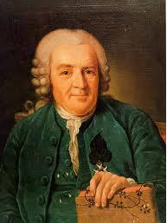
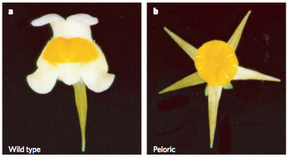
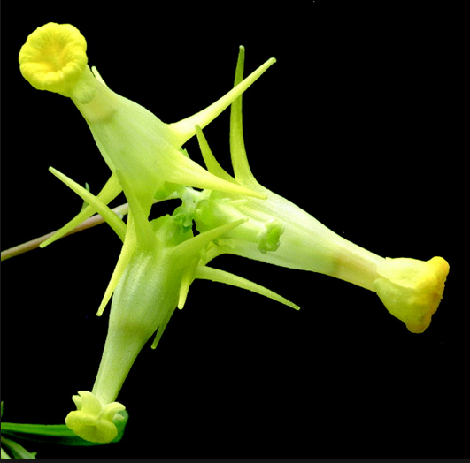

Peloric Toadflax
Carl Linnaeus thought it was a new species
Darwin thought it was a throw back
Geneticists thought it was a mutation
It is an epimutation based on chromatin markers
Carl Linnaeus 1707-1778
In 1868 Darwin showed that the peloric variant bred true, so it is not a hybrid. It followed Mendel’s ratios when crossbred but Darwin did not know about Mendel and did not recognize the implications

Slide 20
Lamarck is Back
In a mouse model, smell → shock lead to startle to the specific smell in the next two generations, even with cross fostering
Effects were associated with epigenetic changes in the olfactory system (hypomethylation in the Olfr151 gene)
Dias & Ressler, Nature Neuroscience, 2014
Notes:
There was no “black box” and no “tabula rasa”
The analysis of biological systems based on variation and selective retention.
My biases are more (b)VSR than BVSR (and the symbolic stream is a good reason why).

Slide 21
Parental Effects
In plants with seeds that do not greatly disperse plants grown in the same light environment as maternal plans have 3.4 times greater fitness than siblings moved to a new light environment
If a daughter mouse is not licked by mother, her brain develops differently due to hypothalamic DNA methylation and as a result will not link her offspring
Notes:
There was no “black box” and no “tabula rasa”
The analysis of biological systems based on variation and selective retention.
My biases are more (b)VSR than BVSR (and the symbolic stream is a good reason why).

Slide 22
Genes Interact with Other Inheritance Systems But Our Analytic Methods Struggle to Quantify These Interactions
Classic example: physical attractiveness is the most powerful demographic variable known
The input is dominantly genetic
The process is dominantly cultural (how do we know? RCTs of plastic surgery)
Twin study fail completely in pulling these two apart – they call it all “genetic”
Notes:
There was no “black box” and no “tabula rasa”
The analysis of biological systems based on variation and selective retention.
My biases are more (b)VSR than BVSR (and the symbolic stream is a good reason why).

Slide 23
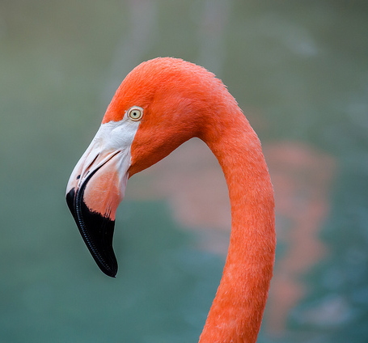
Learning and Niche Selection
Contingency learning is 525-540 Myo
Hugely important in speciation (the “Cambrian explosion”) because it allows organisms to select their environments
Notes:
There was no “black box” and no “tabula rasa”
The analysis of biological systems based on variation and selective retention.
My biases are more (b)VSR than BVSR (and the symbolic stream is a good reason why).

Slide 24
Behavior and Niche Construction:
Major Events in the last 50K Years
The ice age
Agriculture
Animal domestication
Increased population density
Exposure to animal pathogens
Lactose tolerance
Pollution
Deforestation
Global warming
All but one are due to human behavior
Notes:
There was no “black box” and no “tabula rasa”
The analysis of biological systems based on variation and selective retention.
My biases are more (b)VSR than BVSR (and the symbolic stream is a good reason why).

Slide 25
Networks of Learning and Culture
Let me give an animal example: A breed of black rats in Israel have learned to live in trees
Seeing other rats eat pine nuts gets them to try to strip pine cones
The nuts reinforce successful patterns
Pregnant rats alter taste preferences of embryos
Can enter into mate selection
The nuts alter gene expression in digestive system
Living in trees selects other features (claws)
Notes:
There was no “black box” and no “tabula rasa”
The analysis of biological systems based on variation and selective retention.
My biases are more (b)VSR than BVSR (and the symbolic stream is a good reason why).

Slide 26
Multi-Level Selection
Between group competition can advantage cooperative organization if groups and their components survive and reproduce better as a result (this is common)
AND an adequate damper is put on individually selfish adaptations that undermine these actions (this is not common)
Notes:
There was no “black box” and no “tabula rasa”
The analysis of biological systems based on variation and selective retention.
My biases are more (b)VSR than BVSR (and the symbolic stream is a good reason why).

Slide 27
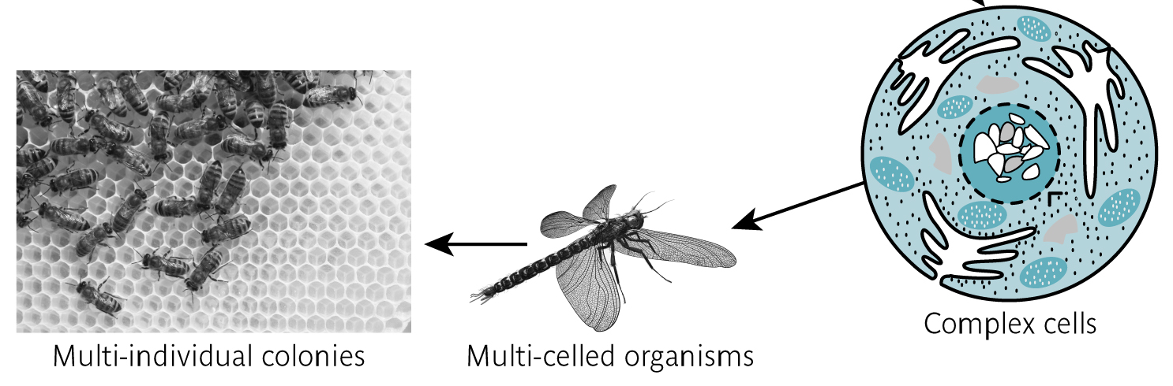
When Both Happen We See
Major Evolutionary Transitions
100 Myo
2 Byo
2.1 - 3 Byo

Slide 28
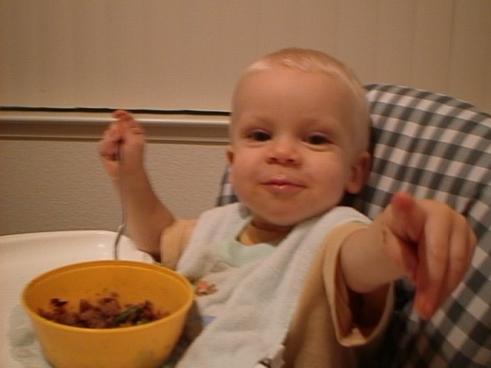
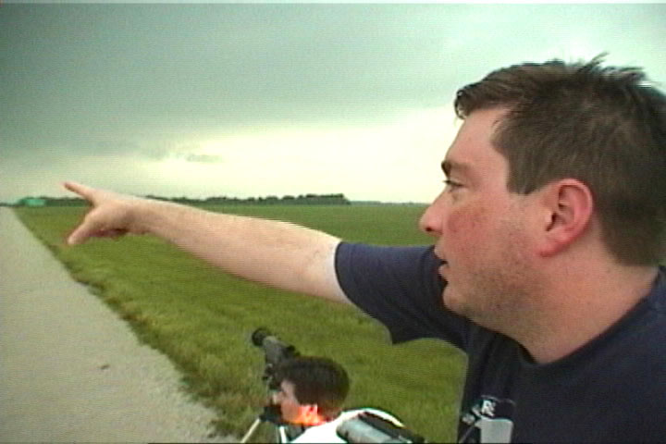
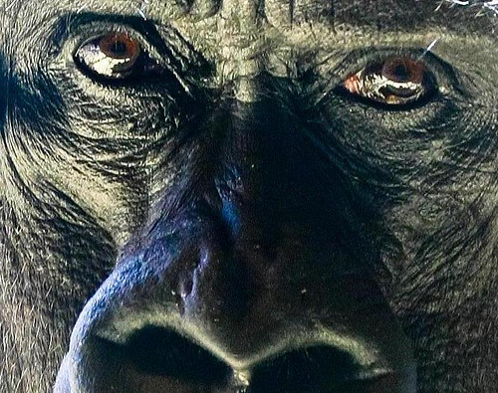

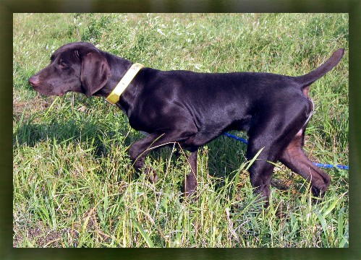

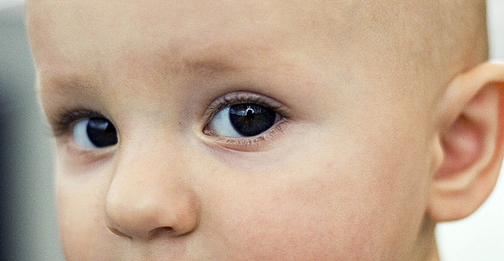
Human Beings Are Arguably a Major Evolutionary Transition

Slide 29
Learning, Behavior and Culture
They create “adaptability drivers” that create larger functional units that then become the benchmark for genetic adaptation (Bateson)
It is not just genes → behavior; it may be even more true that it is behavior → genes
Cells are evolved systems for turning environment and behavior into biology (Cole)
Notes:
There was no “black box” and no “tabula rasa”
The analysis of biological systems based on variation and selective retention.
My biases are more (b)VSR than BVSR (and the symbolic stream is a good reason why).

Slide 30
Inclusive Heritability
Trait Variation
cf Danchin et al., 2011
Transmitted Variation
Non-Transmitted Variation
Genetic Variation
Non-Genetic Transmitted Variation
Epigenetic
Parental
Symbolic
Learning
Ecological
Cultural

Slide 31
Examples in CBS of the
Applicability of EvoS
1. Psychotherapy as
Applied Evolution Science
Notes:
There was no “black box” and no “tabula rasa”
The analysis of biological systems based on variation and selective retention.
My biases are more (b)VSR than BVSR (and the symbolic stream is a good reason why).

Slide 32

Variation

Slide 33

Selection

Slide 34
Retention

Slide 35

Context

Slide 36
Level

Slide 37
Dimension

Slide 38
Variation
Selection
Retention
Context
Level
Dimension

Slide 39

Enemies of Variation: Avoidance

Slide 40
Enemies of Variation:
Excessive Verbal Rule Following

Slide 41
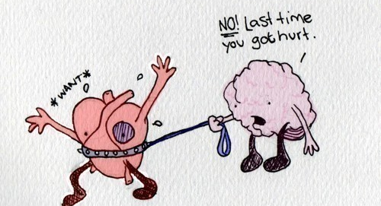
Avoidance and Excessive Verbal Rule Following are Linked: The Mind Puts Our Hearts on a Leash

Slide 42

The ACT / Third Wave Solution:
Put the Mind on a Leash

Slide 43
Promote Variation

Slide 44

Fit the Moment Inside and Out

Slide 45
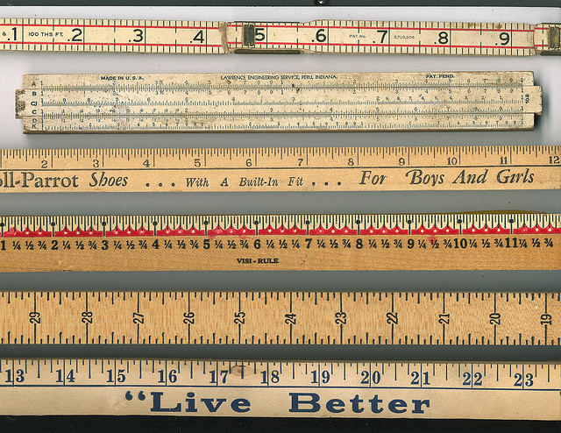
Pick Your Selection Criterion

Slide 46
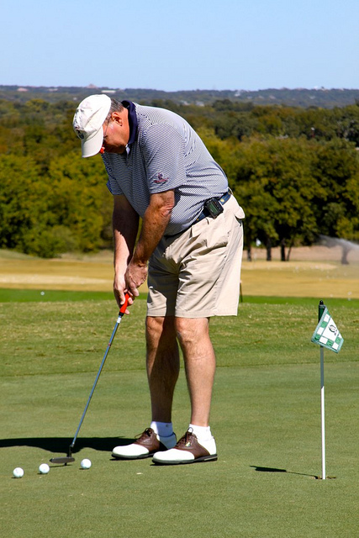
Groove What Works

Slide 47
Open
An ACT Model of Treatment

Slide 48
An ACT Model of Treatment
Aware

Slide 49
Actively Engaged
An ACT Model of Treatment

Slide 50
EvoS Adds Understanding and
New Methods
Variation – Flexible and New
Selection - Values
Retention - Habits
Context – Consciously
Here and Now
Level – Whole and Social
Dimension – In Balance

Slide 51
Examples in CBS
2. Cooperative Basis of RFT
Notes:
There was no “black box” and no “tabula rasa”
The analysis of biological systems based on variation and selective retention.
My biases are more (b)VSR than BVSR (and the symbolic stream is a good reason why).

Slide 52
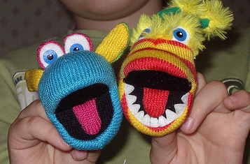
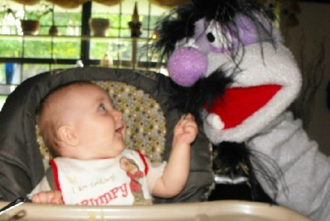
Reward Cooperation
Notes:
My argument … it is human consciousness itself … which forms the link between compassion and self-acceptance

Slide 53
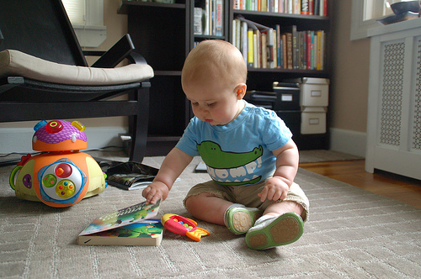
Understand of Intentionality
Notes:
My argument … it is human consciousness itself … which forms the link between compassion and self-acceptance

Slide 54
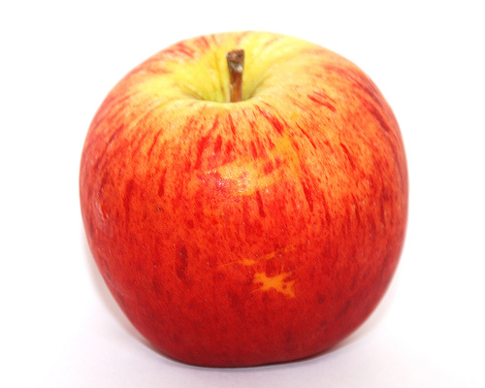
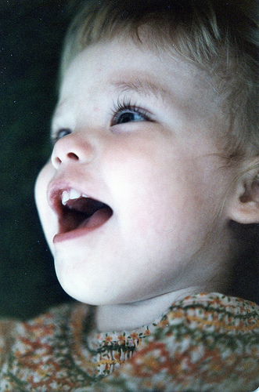
The Beginning AADRR
“Apple”

Slide 55
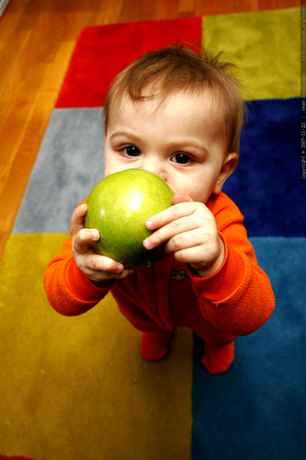
“Where’s the Apple?”

Slide 56
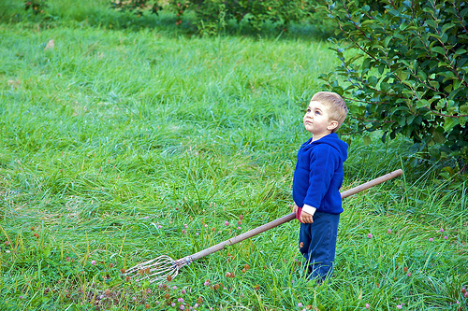
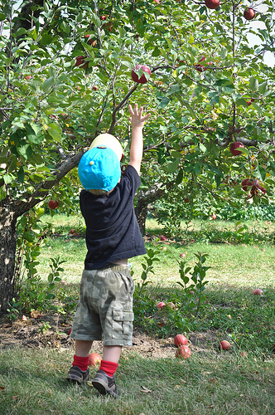
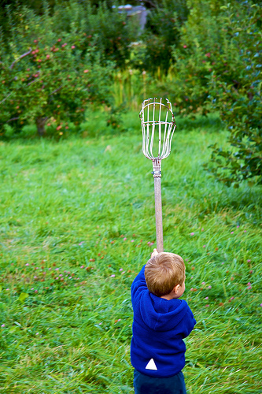
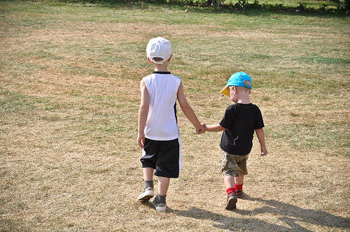
Derived Mutuality was Initially a Social Cooperative Act Based on Non-Verbal Perspective Taking

Slide 57
Examples in CBS
3. Psychopathology and
Experiential Avoidance
Notes:
There was no “black box” and no “tabula rasa”
The analysis of biological systems based on variation and selective retention.
My biases are more (b)VSR than BVSR (and the symbolic stream is a good reason why).

Slide 58
The Collapse of the DSM and the Rise of RDoC
Matrix of five major domains (Negative Valence Systems, Positive Valence Systems, Cognitive Systems, Systems for Social Process, and Arousal & Regulatory Systems)
Seven levels of analysis: gene, molecules, cells, circuits, physiology, behavior, & self-report.
But the report makes clear even in the last two areas “RDoC is an attempt to explore the biological systems relating to these psychological constructs.”
Notes:
There was no “black box” and no “tabula rasa”
The analysis of biological systems based on variation and selective retention.
My biases are more (b)VSR than BVSR (and the symbolic stream is a good reason why).

Slide 59
The Problem with RDoC
In addition to the biocentrism ….
Once again: where is context?
Once again: where is theory?
True, we can’t use narrow speculative theory but why not use the best established integrative theory in the life sciences to structure RDoC?
There is an evolutionarily sensible way to proceed
Notes:
There was no “black box” and no “tabula rasa”
The analysis of biological systems based on variation and selective retention.
My biases are more (b)VSR than BVSR (and the symbolic stream is a good reason why).

Slide 60
Evolutionary Psychopathology
Think of “psychopathology” as self-amplifying or self-sustaining multi-dimensional, multi-level processes impacting behavioral and cognitive domains that restrict needed variation, selection, retention, or sensitivity to context, across relevant dimensions and/or levels.
Psychopathology is evolution gone awry: an adaptive peak that prevents further positive development via normal evolutionary processes.
Notes:
There was no “black box” and no “tabula rasa”
The analysis of biological systems based on variation and selective retention.
My biases are more (b)VSR than BVSR (and the symbolic stream is a good reason why).

Slide 61
Experiential Avoidance and RDoC Areas
EA is a strong predictor of poor mental and behavioral health
It can have the paradoxical effect of increasing their frequency or intensity of targeted events
Impacts brain functioning, eg greater lateralization and reduced frontal and limbic reactivity during avoidance trials
Some evidence that EA is an endophenotype as related to the 5HTT gene
Notes:
There was no “black box” and no “tabula rasa”
The analysis of biological systems based on variation and selective retention.
My biases are more (b)VSR than BVSR (and the symbolic stream is a good reason why).

Slide 62
Evolutionary Criteria Helps Us See
Experiential Avoidance As a Disorder
EA is higher given early aversive experiences that lead to epigenetic changes in stress related genes and behavioral attempts to avoid
EA restricts behavioral, cognitive, and neurophysiological variation
EA restricts context sensitivity, making it harder to learn from errors
Notes:
There was no “black box” and no “tabula rasa”
The analysis of biological systems based on variation and selective retention.
My biases are more (b)VSR than BVSR (and the symbolic stream is a good reason why).

Slide 63
Treatment of Experiential Avoidance
Any method of intervention that increases emotional, cognitive, and behavioral flexibility in the presence of repertoire narrowing stimuli that occasion EA, should be helpful.
That seems to be the case
And they alter the biological associates associated with EA such as epigenetic regulation of stress related genes (Kaliman et al., 2014)
8 weeks of meditation alters 1,500 genes, mostly stress hormone related
Notes:
There was no “black box” and no “tabula rasa”
The analysis of biological systems based on variation and selective retention.
My biases are more (b)VSR than BVSR (and the symbolic stream is a good reason why).

Slide 64
Examples in CBS
4. The Importance of the Group
Notes:
There was no “black box” and no “tabula rasa”
The analysis of biological systems based on variation and selective retention.
My biases are more (b)VSR than BVSR (and the symbolic stream is a good reason why).

Slide 65
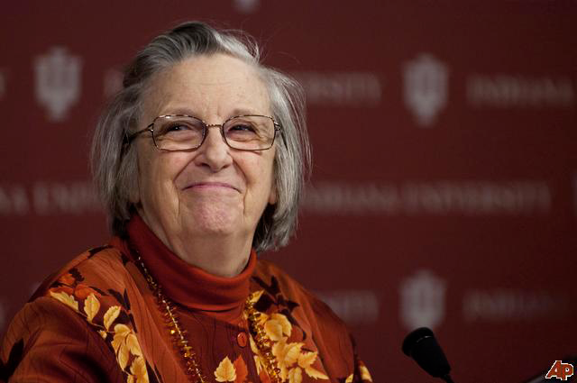
Elinor Ostrom
2009 Nobel Prize in Economics

Slide 66
Elinor Ostrom’s Eight Principles
1) Clearly defined groups
2) Proportional equivalence between benefits and costs
3) Collective-choice
4) Monitoring
5) Graduated sanctions
6) Conflict resolution mechanisms
7) Right to organize
8) Nested enterprises

Slide 67
The PROSOCIAL Project
Training in Ostrom’s principles have been combined with the ACT and the Matrix
After years of development work it is doing a soft release tomorrow in a web-based training program, developed by the Evolution Institute (Wilson, Miller, Honick) and ACBS researchers (Atkins, Biglan, Bond, Ciarrochi, Polk, myself)

Slide 68

prosocialgroups.org

Slide 69
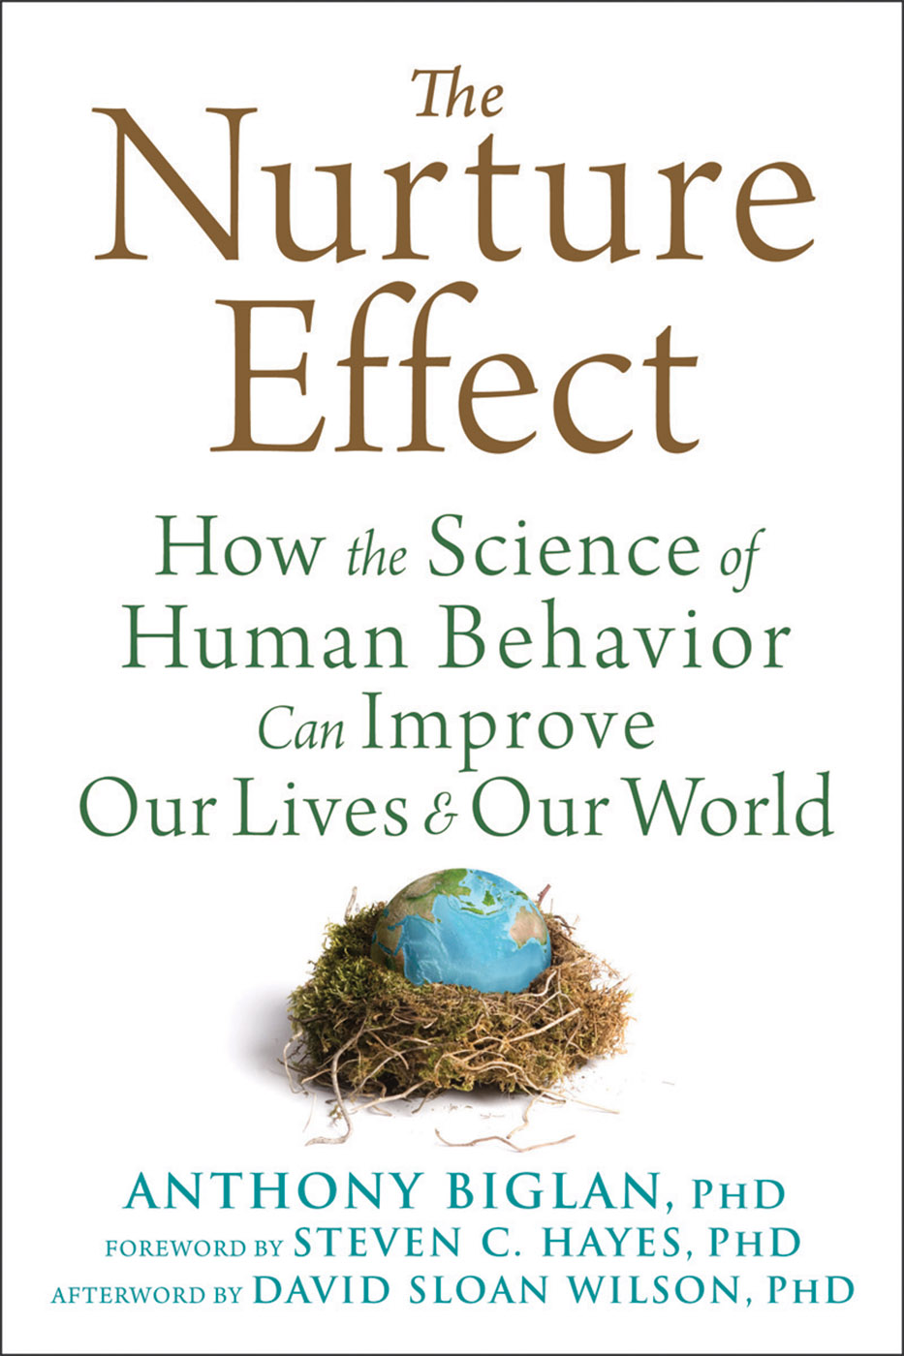
www.newharbinger.com/nurture-effect

Slide 70
Examples in CBS
5. Social Change
Notes:
There was no “black box” and no “tabula rasa”
The analysis of biological systems based on variation and selective retention.
My biases are more (b)VSR than BVSR (and the symbolic stream is a good reason why).

Slide 71
Reaching the Need:
ACT / PROSOCIAL in Sierra Leone
6 M people in Sierra Leone: 1 psychologist; 1 retired psychiatrist
2010 Beate Ebert started Commit and Act
ABCS brought 5 health workers to World Con (2010, 2012)
ACT trainers flew into Sierra Leone (2011-present)

Slide 72
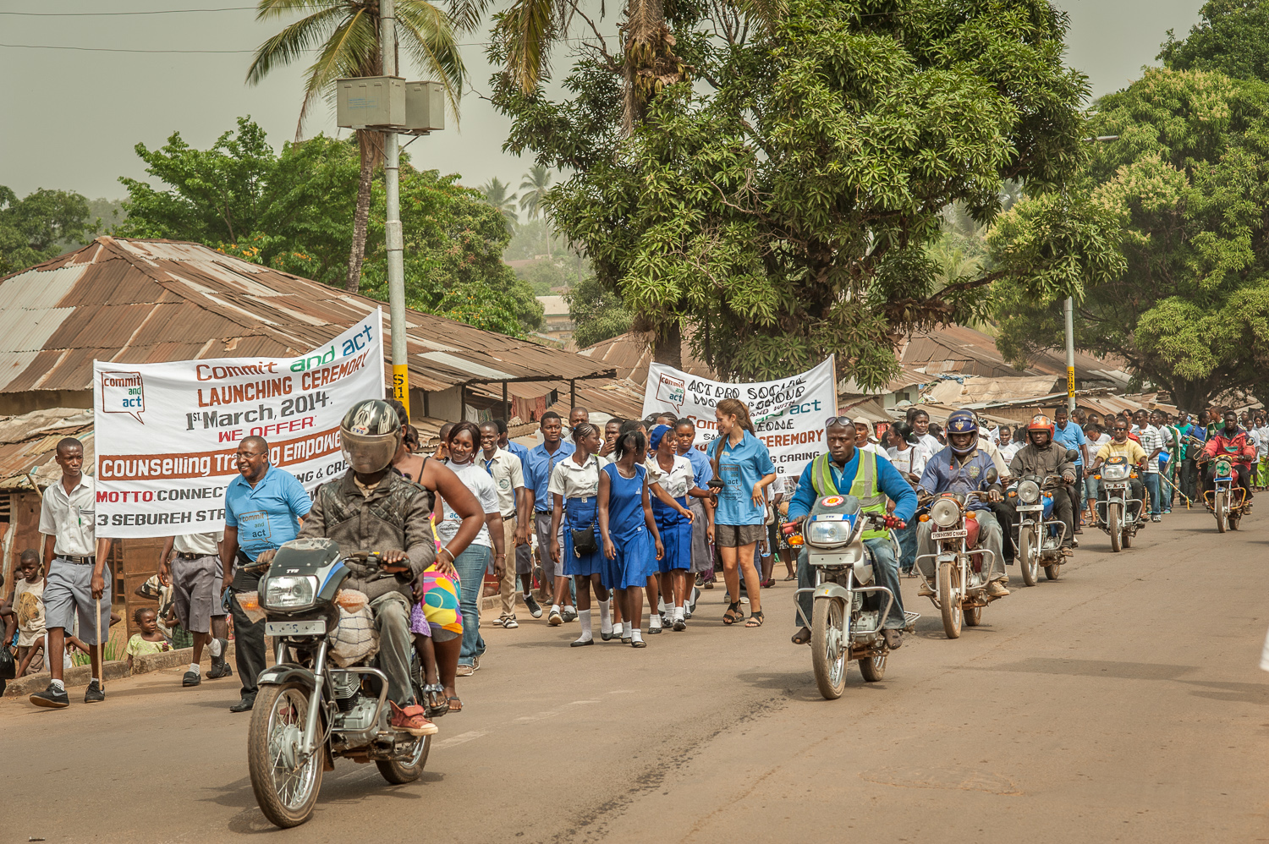
In Spring 2014 a New Clinic in Bo

Slide 73
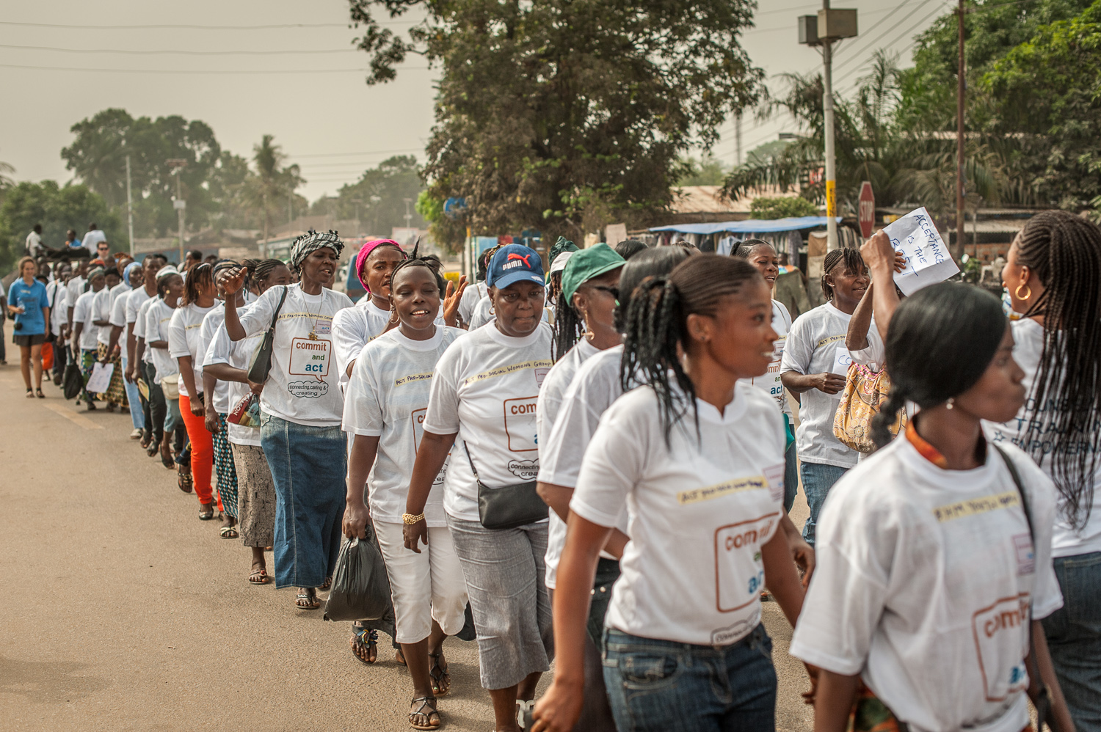
The Commit and Act Clinic in Bo

Slide 74
Now Here Comes Ebola and the Clinic Director, Hannah Bockarie, is Named the Bo Ebola Response Director
The country is isolated; the aid workers leave;
Thousands die; Thousands more infected
Hannah is named director for Ebola prevention in her district by the Ministry of Health and Sanitation
Her approach: involve the people directly in ACT / PROSOCIAL based workshops

Slide 75
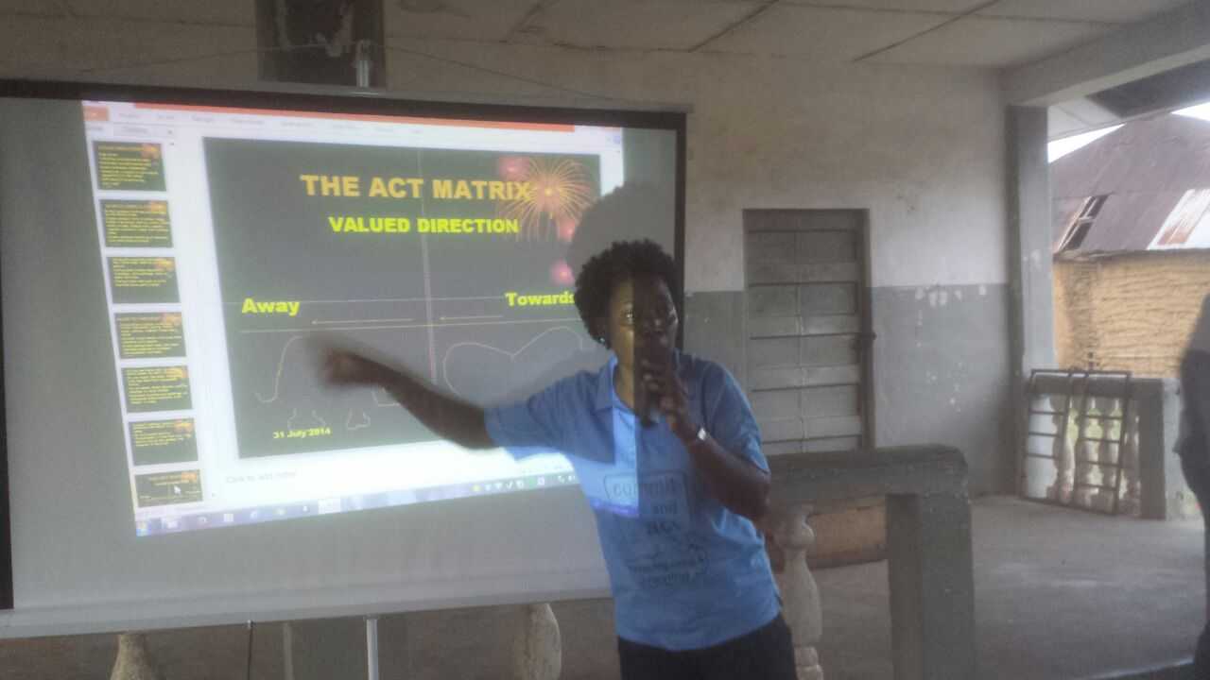
Using the ACT / PROSOCIAL
Hannah Bockarie

Slide 76
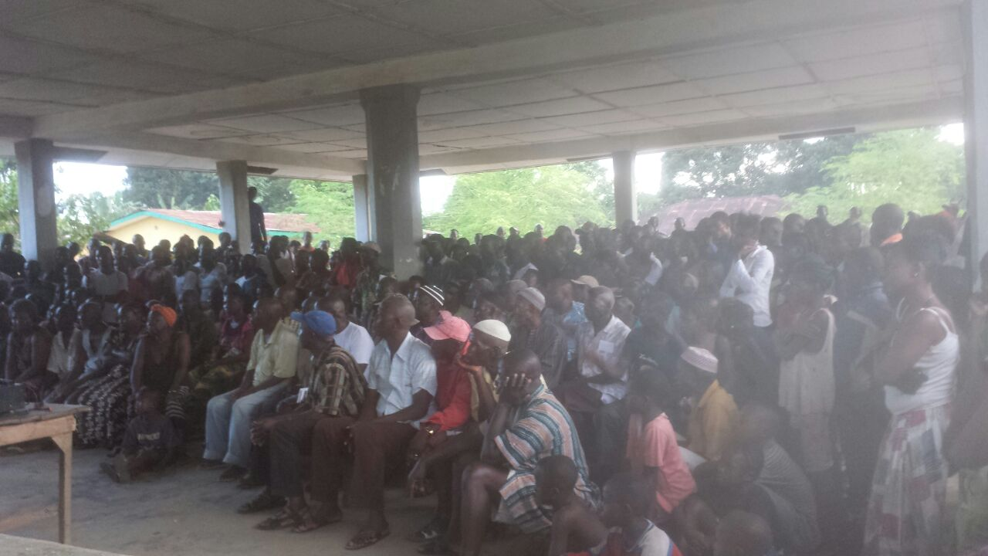
With An Entire Community

Slide 77
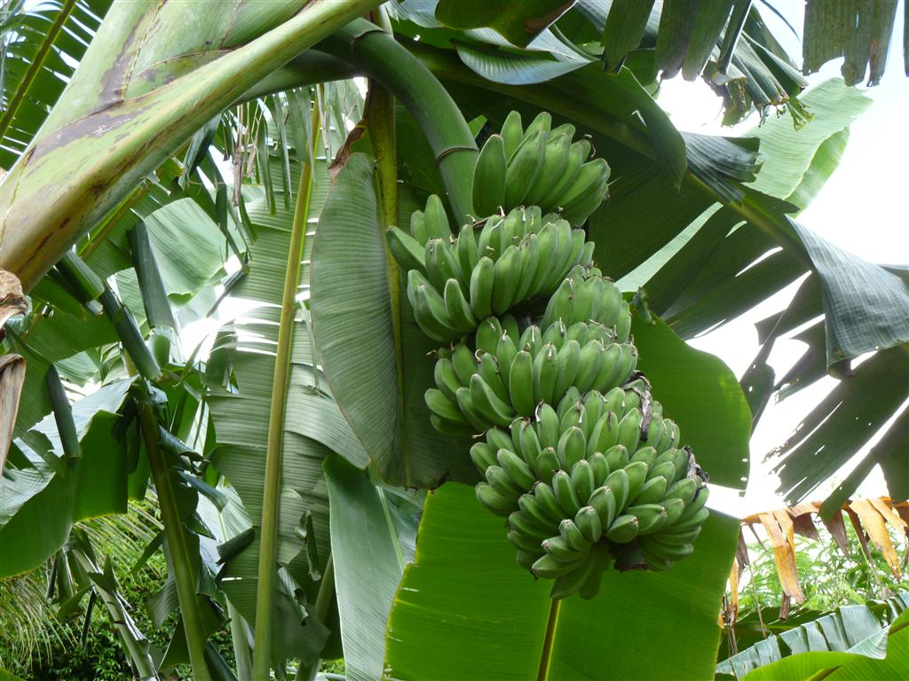
Example of Solutions
Example of their solutions:
You must kiss the body of the dead before burial.
What to do?
Kiss and bury a banana trunk
Bo infection infection increase slows

Slide 78
Bo

Slide 79
Examples in CBS
6. Making and Supporting Our Friends
Notes:
There was no “black box” and no “tabula rasa”
The analysis of biological systems based on variation and selective retention.
My biases are more (b)VSR than BVSR (and the symbolic stream is a good reason why).

Slide 80
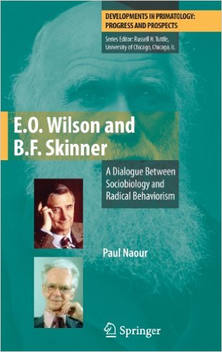
Notes:
There was no “black box” and no “tabula rasa”
The analysis of biological systems based on variation and selective retention.
My biases are more (b)VSR than BVSR (and the symbolic stream is a good reason why).

Slide 81
Notes:
There was no “black box” and no “tabula rasa”
The analysis of biological systems based on variation and selective retention.
My biases are more (b)VSR than BVSR (and the symbolic stream is a good reason why).

Slide 82
Our Challenge
Includes developing CBS in the context of our sister sciences.
The resistance to global behavioral interventions is in part a cultural echo of the failure of evolution as a guide to social change -- due to a limited vision of evolution itself
Notes:
There was no “black box” and no “tabula rasa”
The analysis of biological systems based on variation and selective retention.
My biases are more (b)VSR than BVSR (and the symbolic stream is a good reason why).

Slide 83
Conclusion
A new form of applied evolution science is emerging as contextual behavioral psychology is reunified with its natural home base
CBS is already making progress because of it
The global impact of CBS requires that we redirect evolution science itself toward a multi-dimensional, multi-level view that rejects gene centrism and embraces a comprehensive applied science of intentional change
Notes:
There was no “black box” and no “tabula rasa”
The analysis of biological systems based on variation and selective retention.
My biases are more (b)VSR than BVSR (and the symbolic stream is a good reason why).

